Slide 1
Art of successful startup - AI for Social good
Vaishnavi V

Slide 2
the clear winner in the AI race so far
The stock of this company is up 167% so far in 2023

Slide 3
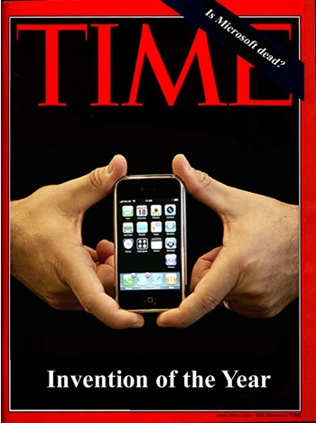
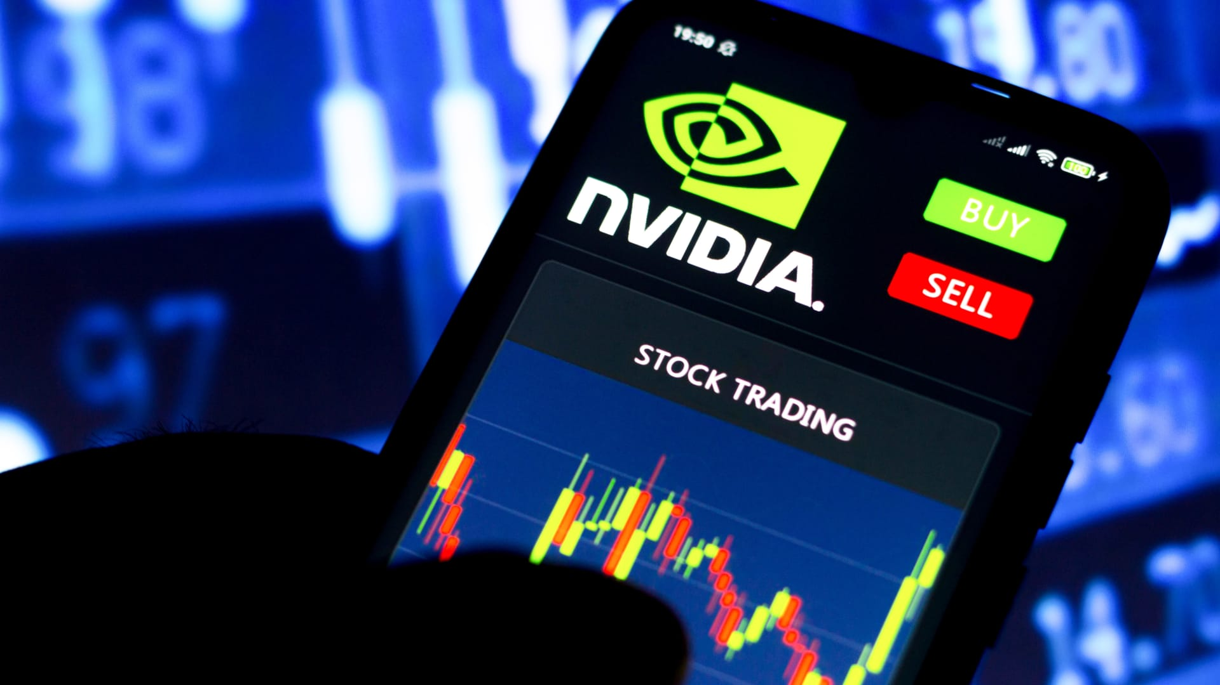
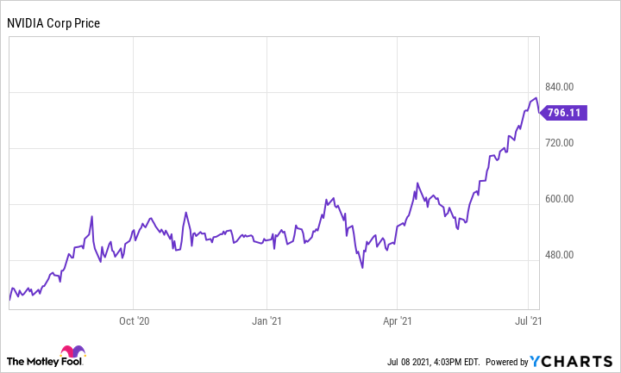
the clear winner in the AI race so far
We are at the iPhone moment for AI,
Notes:
The most popular deep learning workload of late is ChatGPT, in beta from Open.AI, which was trained on Nvidia GPUs. According to UBS analyst Timothy Arcuri, ChatGPT used 10,000 Nvidia GPUs to train the model.

Slide 4
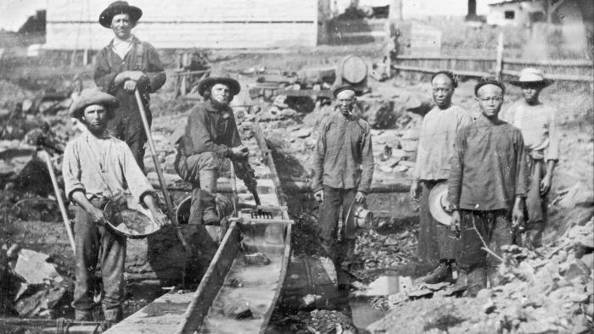
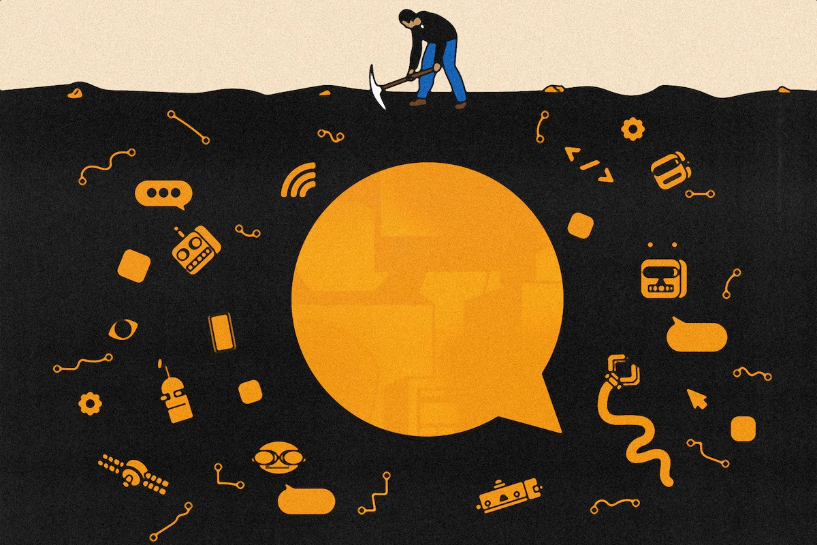
Californian gold rush
Gold miners in California in 1852.
Today’s ‘picks and shovels’
Notes:
Gold miners in California in 1852. The big cloud computing companies, AWS, Google and Microsoft, will profit from the models’ voracious demand for computing power. But Nvidia, the dominant designer of graphics processing units that power most AI models, also stands out. “We are at the iPhone moment for AI,”

Slide 5
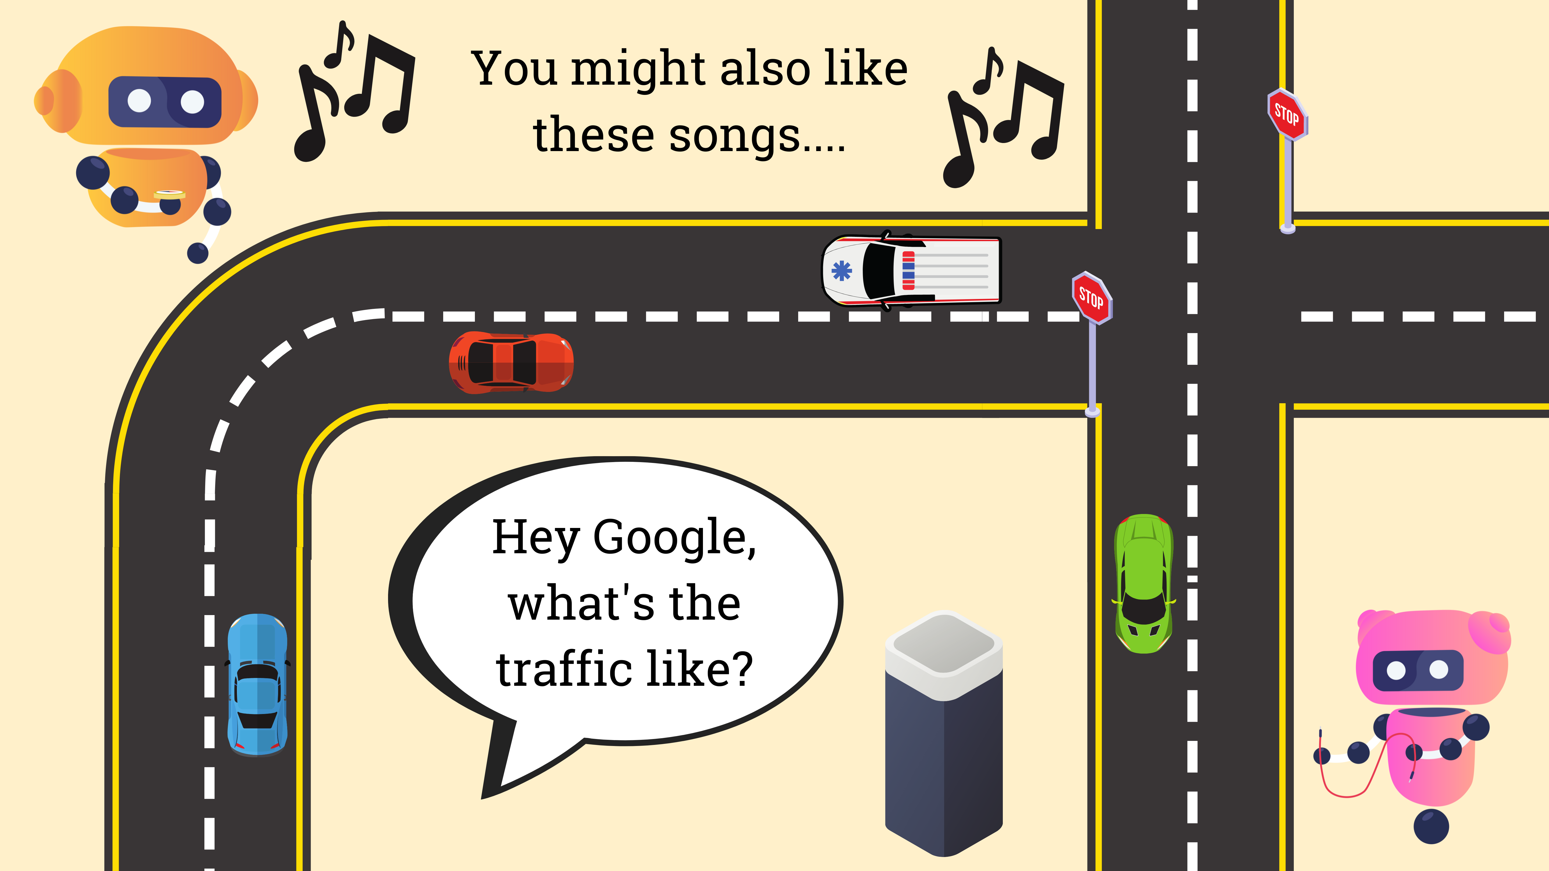

Slide 6
examples
Self-Driving Cars: Have you ever seen a self-driving car? What about a self-parking car? Autonomous vehicles are transforming mobility, using sensors to detect their surroundings.
Virtual Assistants: Hey Siri. OK Google. Alexa. Virtual assistants use natural language processing to respond to your questions and requests.
Music Recommenders: If you have ever listened to music on an app like Spotify, maybe you have noticed recommendations appear for songs you might like. That’s thanks to AI!
Source : https://www.inspiritscholars.com/blog/ai-for-social-good-projects/
Notes:
designed to be a “blueprint to achieve a better and more sustainable future for all” by 2030

Slide 7
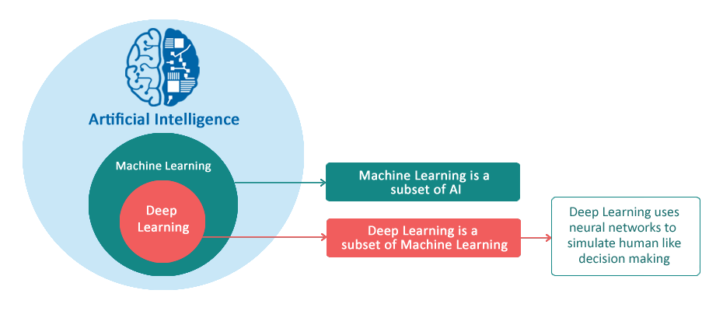
basics
Machine Learning : Machine Learning is an art of study of
algorithms and learning from examples and experience.
ML enables us to make predictions based on existing patterns in the data.
Deep Learning : Deep learning uses neural network that
comprises of different layers to learn from data.
Neural Network is an architecture where the layers
are stacked on top of each other.

Slide 8
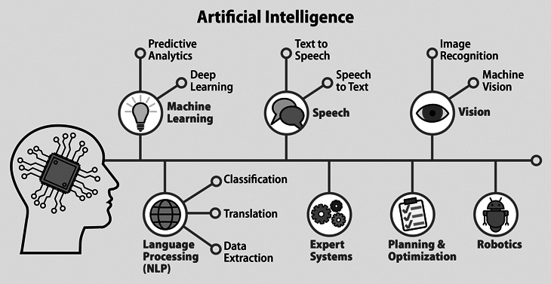
basics

Slide 9
Sustainable Development Goals
In 2015, the United Nations General Assembly announced a collection of 17 interlinked global goals, called the Sustainable Development Goals.
Its designed to be a “blueprint to achieve a better and more sustainable future for all” by 2030
These global goals encompass the majority of the world’s most pressing problems, including climate change, poverty, and access to clean water.
Notes:
designed to be a “blueprint to achieve a better and more sustainable future for all” by 2030

Slide 10
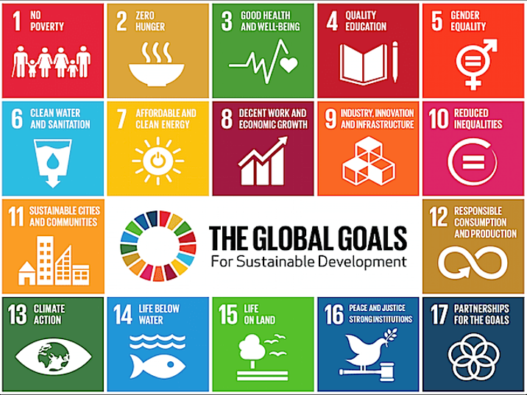
AI4SDGs

Slide 11
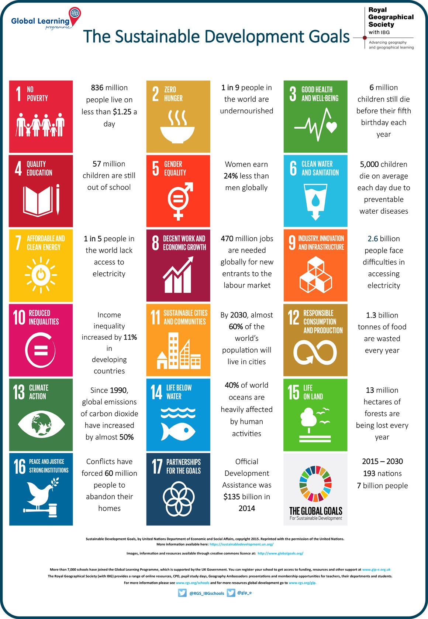
Notes:
ESG (environment, social, governance), which is now, increasingly often, replacing the older term CSR (corporate social responsibility)

Slide 12
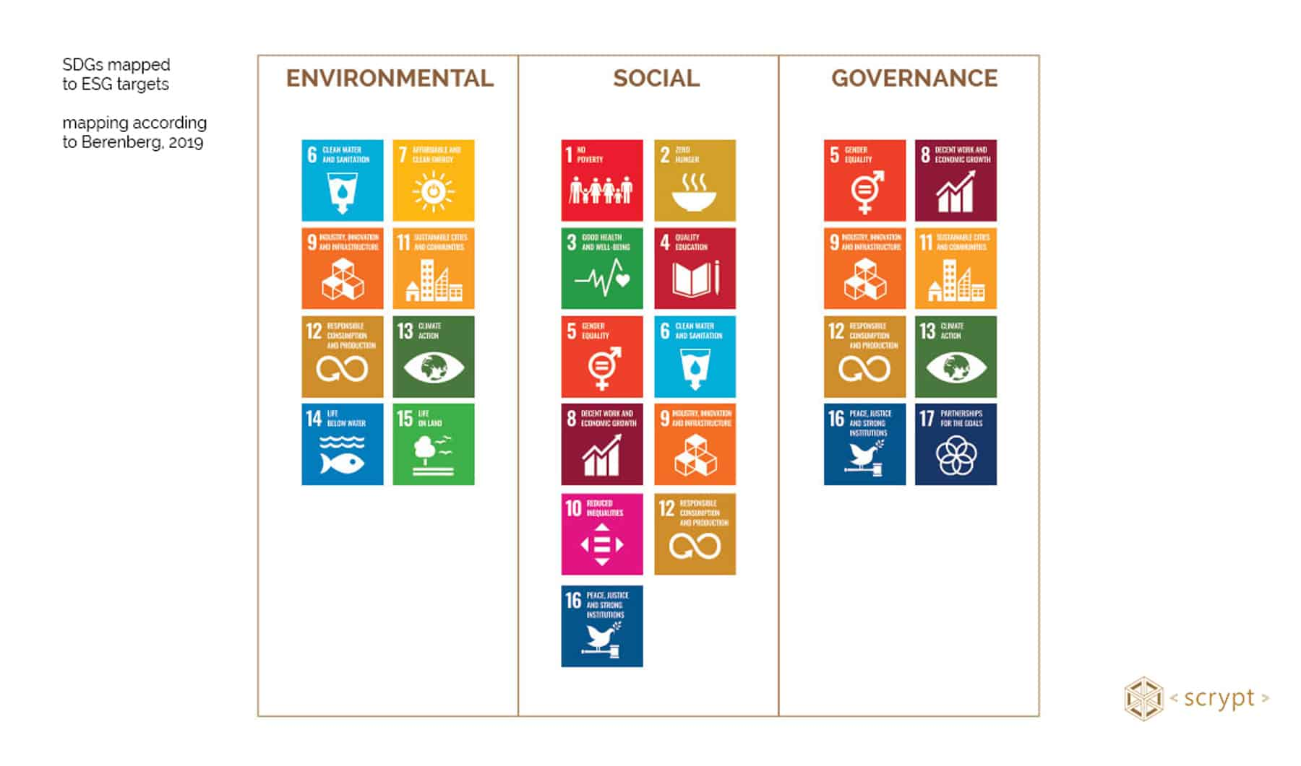
ESG Lens

Slide 13
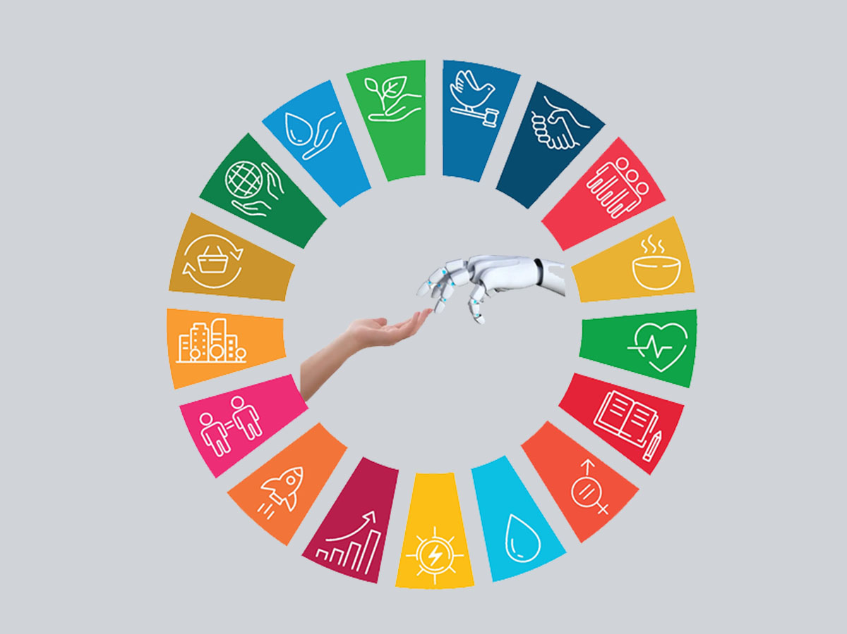
AISG

Slide 14
Good Health and Well-Being (SDG #3): Disease-detection AI system can be used to diagnose if skin lesions are cancerous.
Quality Education (SDG #4): Adaptive-learning technology can maximize student achievement by recommending content to students based on their past success (McKinsey).
Climate Action (SDG #13): AI can be used to efficiently place energy creating sources (like wind, solar, and gas) to combat climate change.

Slide 15
AI + Healthcare: With computer vision, diagnosing patients based on medical scans such as X-rays.
AI + Sustainability: Using AI to efficiently place energy creating sources (wind, solar, gas) across a country to maximize coverage.
AI + Mobility: Applying AI to create a safe and synchronized auto pilot system for cars.
AI + Ethics: Leveraging machine learning to predict returns of portfolios and create optimal combinations of assets.

Slide 16
Models
Text is the most advanced domain. However, natural language is hard to get right, and quality matters. Today, the models are decently good at generic short/medium-form writing (but even so, they are typically used for iteration or first drafts). Over time, as the models get better, we should expect to see higher quality outputs, longer-form content, and better vertical-specific tuning.
Code generation is likely to have a big impact on developer productivity in the near term as shown by GitHub CoPilot. It will also make the creative use of code more accessible to non developers.
Images are a more recent phenomenon, but they have gone viral: it’s much more fun to share generated images on Twitter than text! We are seeing the advent of image models with different aesthetic styles, and different techniques for editing and modifying generated images.

Slide 17
Models
Speech synthesis has been around for a while (hello Siri!) but consumer and enterprise applications are just getting good. For high-end applications like film and podcasts the bar is quite high for one-shot human quality speech that doesn’t sound mechanical. But just like with images, today’s models provide a starting point for further refinement or final output for utilitarian applications.
Video and 3D models are coming up the curve quickly. People are excited about these models’ potential to unlock large creative markets like cinema, gaming, VR, architecture and physical product design. The research orgs are releasing foundational 3D and video models as we speak.
Other domains: There is fundamental model R&D happening in many fields, from audio and music to biology and chemistry (generative proteins and molecules, anyone?).

Slide 18
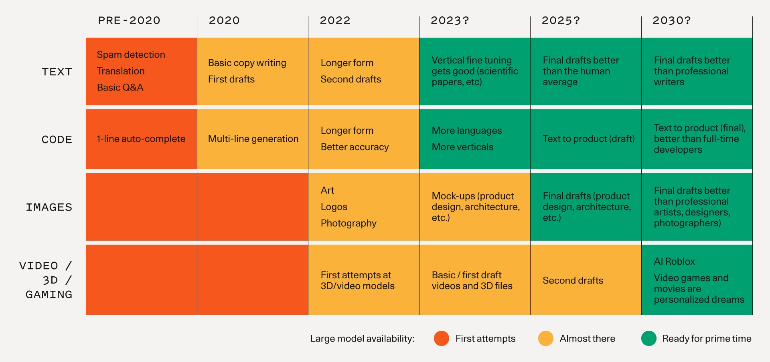
Timeline

Slide 19
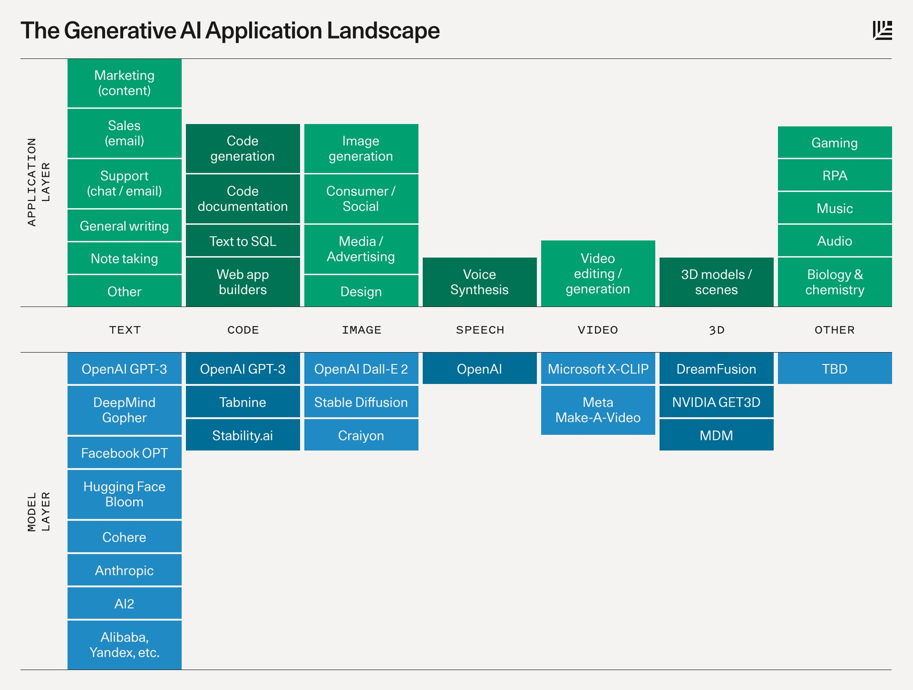
Timeline

Slide 20
Anatomy of a Generative AI Application
Intelligence and model fine-tuning
Little Brain
Generative AI apps are built on top of large models like GPT-3 or Stable Diffusion. As these applications get more user data, they can fine-tune their models to: 1) improve model quality/performance for their specific problem space and; 2) decrease model size/costs.
Generative AI apps as a UI layer and “little brain” that sits on top of the “big brain” that is the large general-purpose models
Form Factor
Paradigm of Interaction
Generative AI apps largely exist as plugins in existing software ecosystems. Code completions happen in your IDE; image generations happen in Figma or Photoshop; even Discord bots are the vessel to inject generative AI into digital/social communities.
Generative AI outputs are being used as prototypes or first drafts
Source : https://www.sequoiacap.com/article/generative-ai-a-creative-new-world/

Slide 21
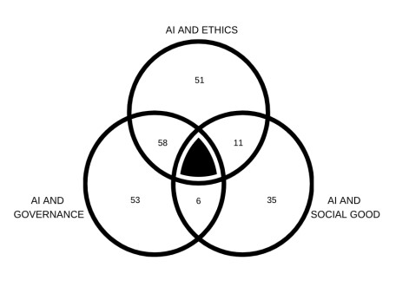
Global Partnership on AI (GPAI)
Source : https://gpai.ai/projects/responsible-ai/areas-for-future-action-in-responsible-ai.pdf

Slide 22
Global Partnership on AI (GPAI)
Ethics
Governance
Social Good
Ethical frameworks and guidelines promoting & fostering Responsible AI
Governance mechanisms operationalizing Responsible AI
Applied projects advancing SDGs responsibly
Notes:
training a single deep-learning model can result in the emission of 284,000 kilograms of CO2.

Slide 23

TRUSTED AI

Slide 24
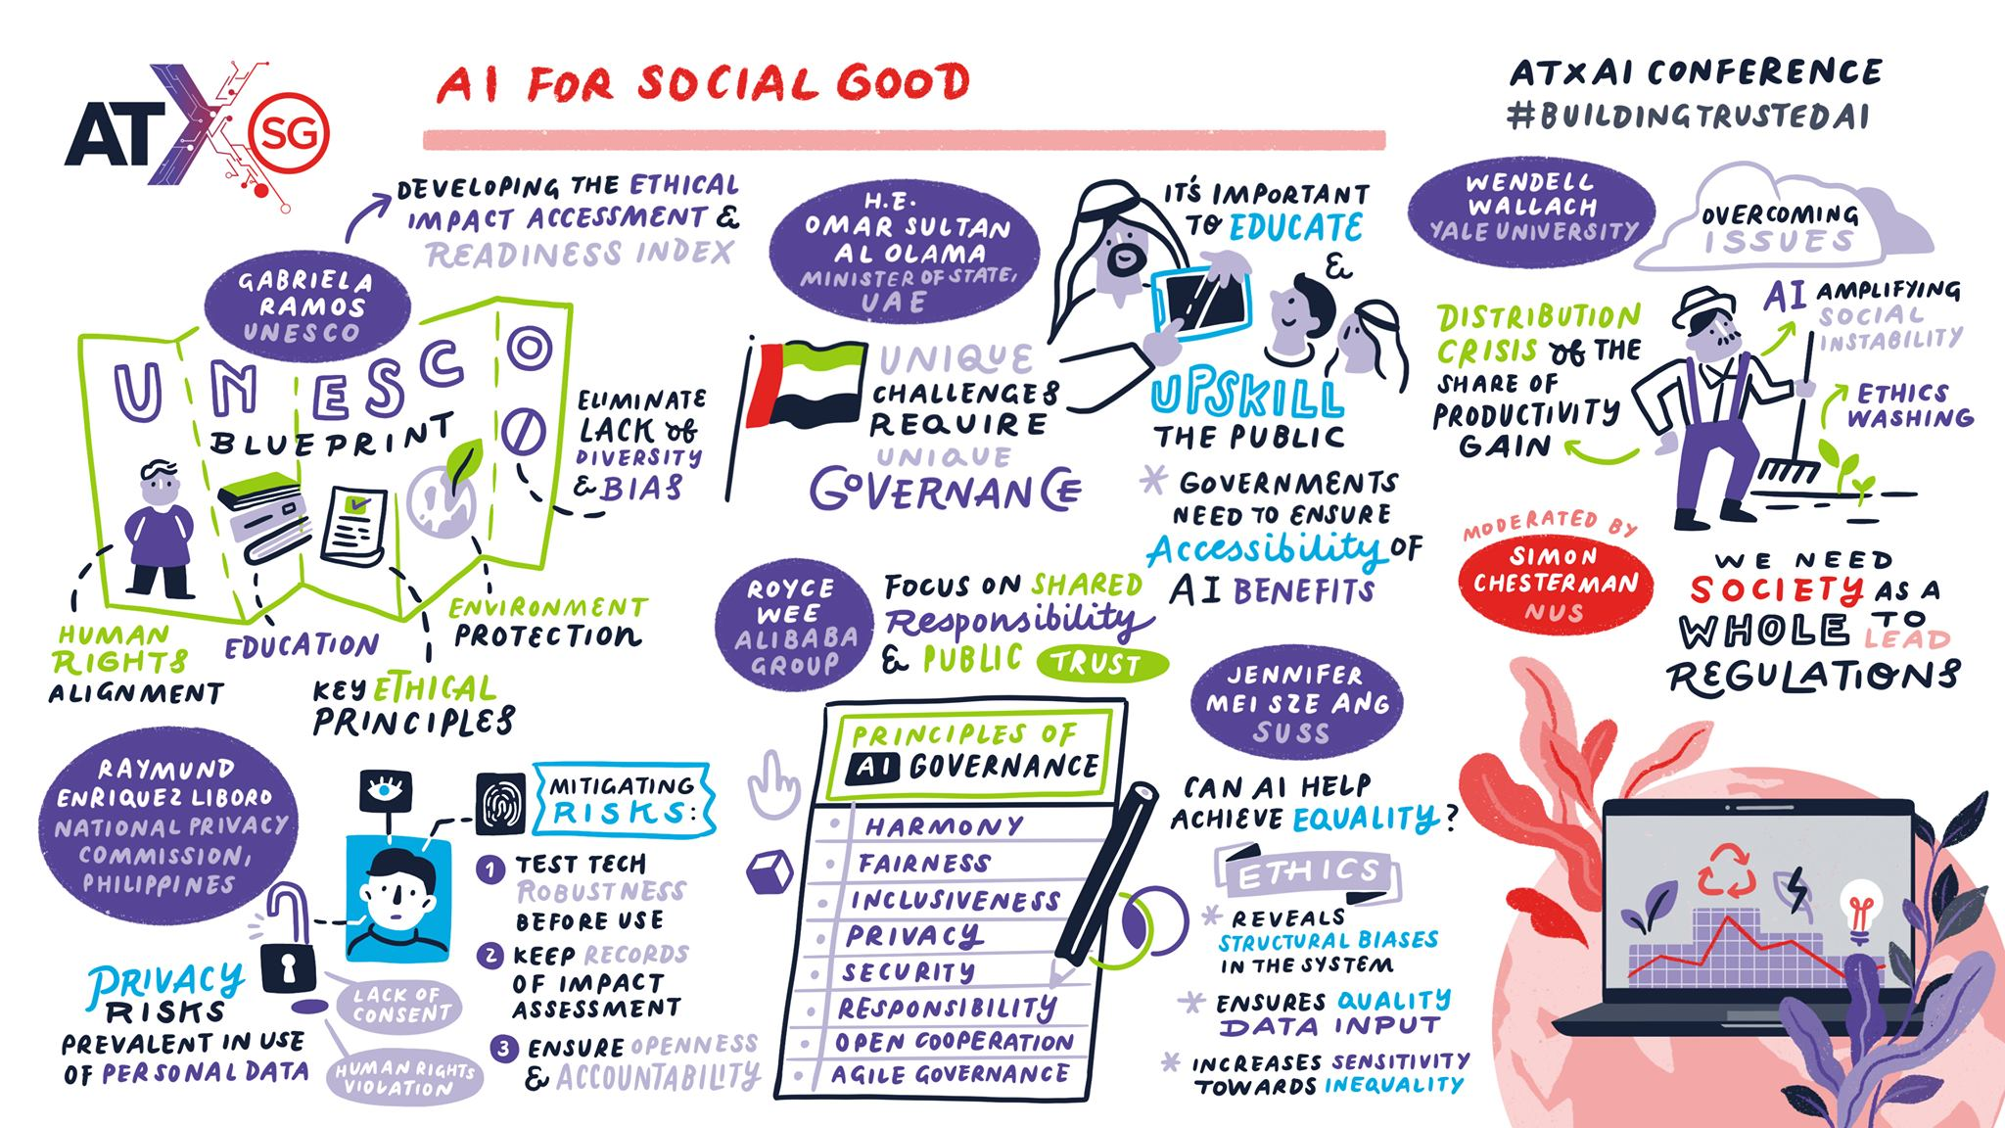
\
Notes:
Source : https://www.imda.gov.sg/resources/blog/blog-articles/2021/08/building-a-better-world-with-trustworthy-ai

Slide 25
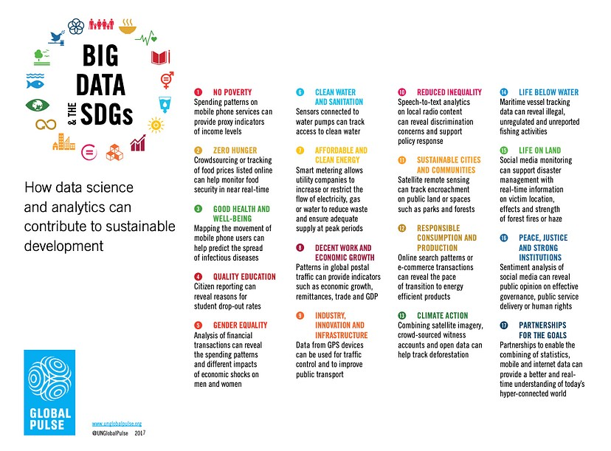

Slide 26
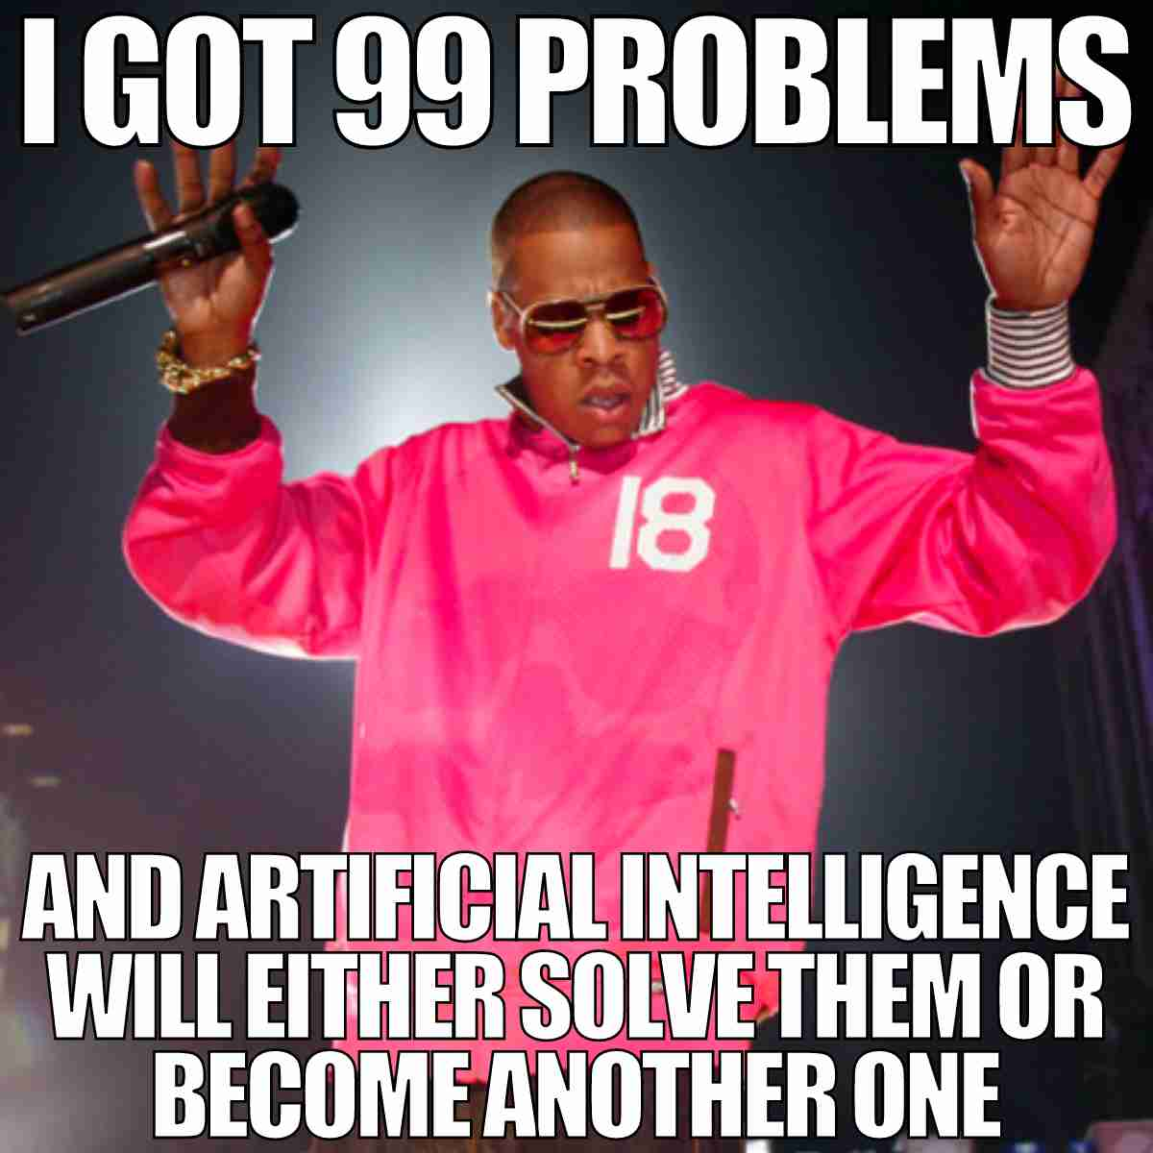
SUMMARY
Data are not homogeneous; they can come from different sources and be used for different purposes. The choice of which training data to use may be competitively significant as certain attributes of training data are a better fit with specific algorithms and products than others.

Slide 27
THANK YOU
Vaishnavi V

